Slide 1
Project 2: Linear regression
King county housing data
Eric Hansen
Flatiron dS; self paced
9/7/2021

Slide 2

Background
Problem – Provide insight into most influential factors when buying/selling a home
Stakeholder – family selling and potentially buying home in Seattle area
Data – Kings County, WA Home Sale data; 2014-2015
Model – Multiple Regression
Goals
Identify areas for improvement of current home/ areas of savings for future home
Identify strategic timing for sale/purchase
This Photo by Unknown Author is licensed under CC BY-SA

Slide 3
Methodology
1) I performed Exploratory Data Analysis to identify characteristics of the data
2) I created several new features including grade squared, day of the week, month.
3) I performed multiple linear regression (with one polynomial regression term) under several different permutations (e.g. logging numericals, scaling numericals, and different ways of classifying categoricals/numeric values
4) I identified a model that had a good Score as well as minimal multicollinearity.
5) I examined the necessary conditions of linear regression
6) The business takeaways: sqft_living, grade_squared, zipcode_avg, waterfront, View, day of week (namely Saturday vs Sunday) all have a (normalized) significant impact on price. The top 6 coefficients in descending order are: zipcode_avg, view_3.0, view_4.0, waterfront_1.0, sqft_living, and grade_squared.
Furthermore, the model is ready to accept any new home predictors for comparison to current prices, in order to establish if a home is over- or under-valued.

Slide 4
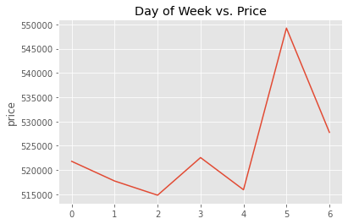
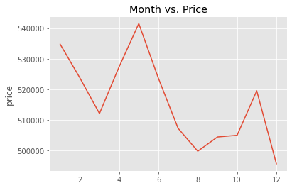
Results 1 – Average Price vs time

Slide 5

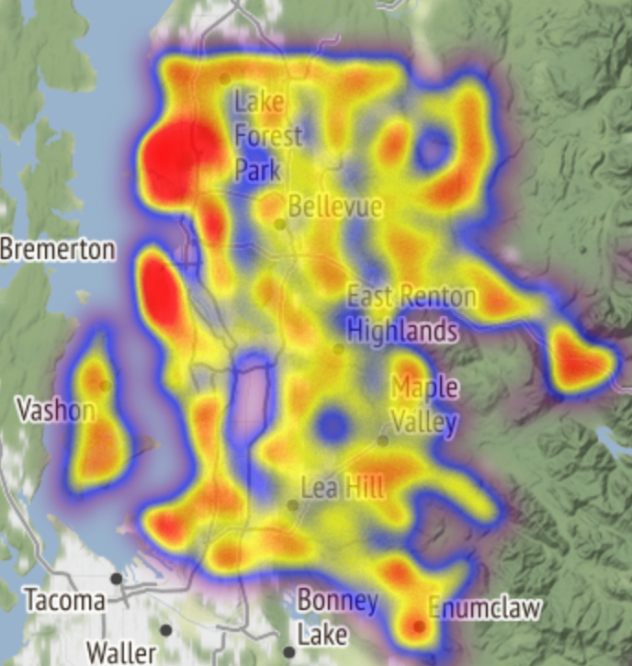
Results 2
This map illustrates the price differentials by location. Zipcode_avg_price served as a representation of this in the model.
Future work could include looking at pricing trends since 2015 to identify what neighborhoods have upwardly trending prices.

Slide 6
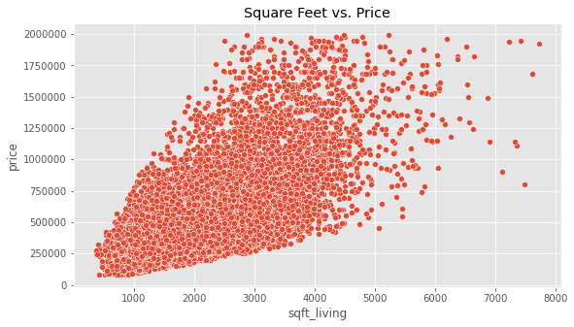
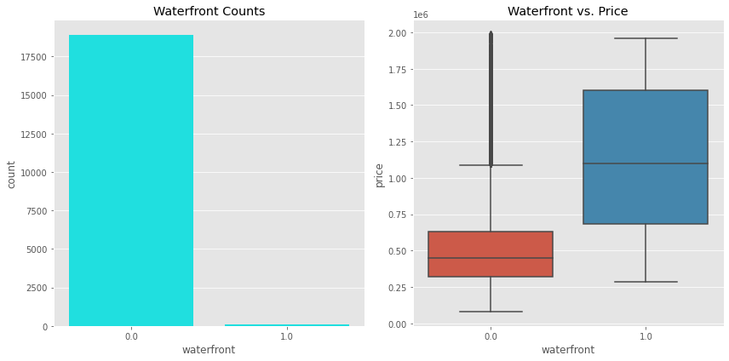
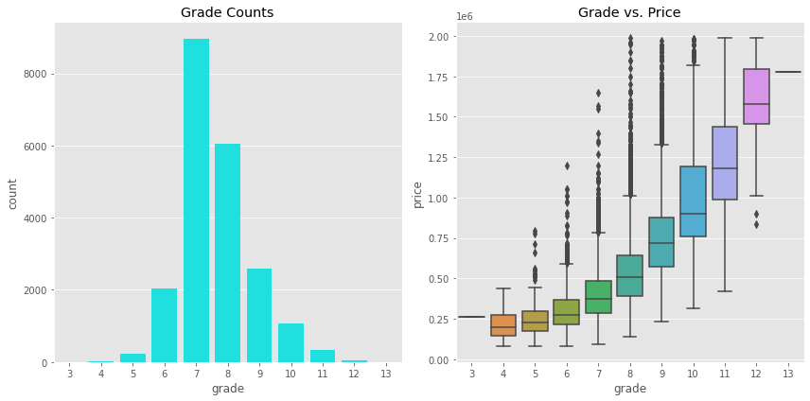
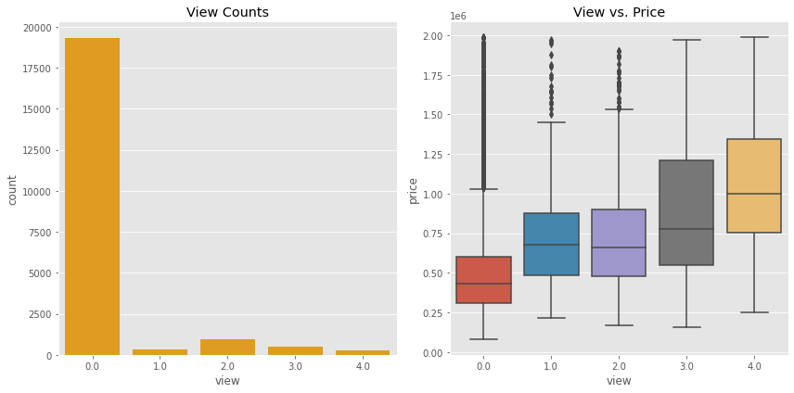
Results 3

Slide 7

Conclusions/questions
Linear regression model has identified some characteristics to dial in on.
As stated earlier, the top 6 coefficients of linear regression, in descending order, are: zipcode_avg, view_3.0, view_4.0, waterfront_1.0, sqft_living, and grade_squared.
This model had an R^2 value of 0.8241. Compared to a ceiling of 1.0, and maintaining good interpretability of predictors, this is a strong result.
Actionable items:
Strategically time home sale/purchase during the year and even within the week
Examine locations/zipcodes carefully. In the future, could project zipcodes with desirable growth
Improve grade/square footage of current home to increase its value
Identify future homes for purchase where grade/square footage are not yet maximized
Use linear regression or other model to investigate current / prospective home price points.
Questions?

